Slide 2
DevOps and Internal Audit: A Great Partnership (Part 2)
Nationwide Insurance
Ethan Culp, Rusty Lewis, Clarissa Lucas

Slide 3
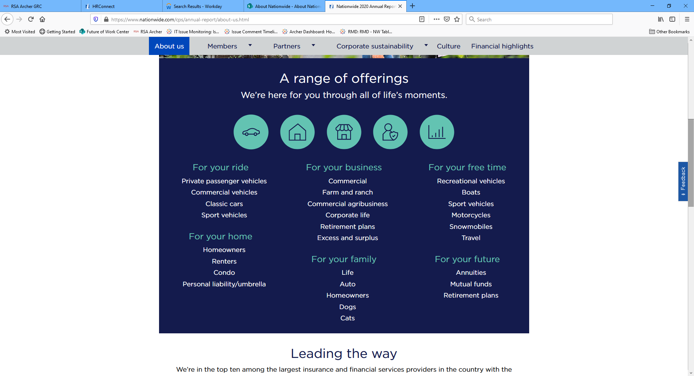
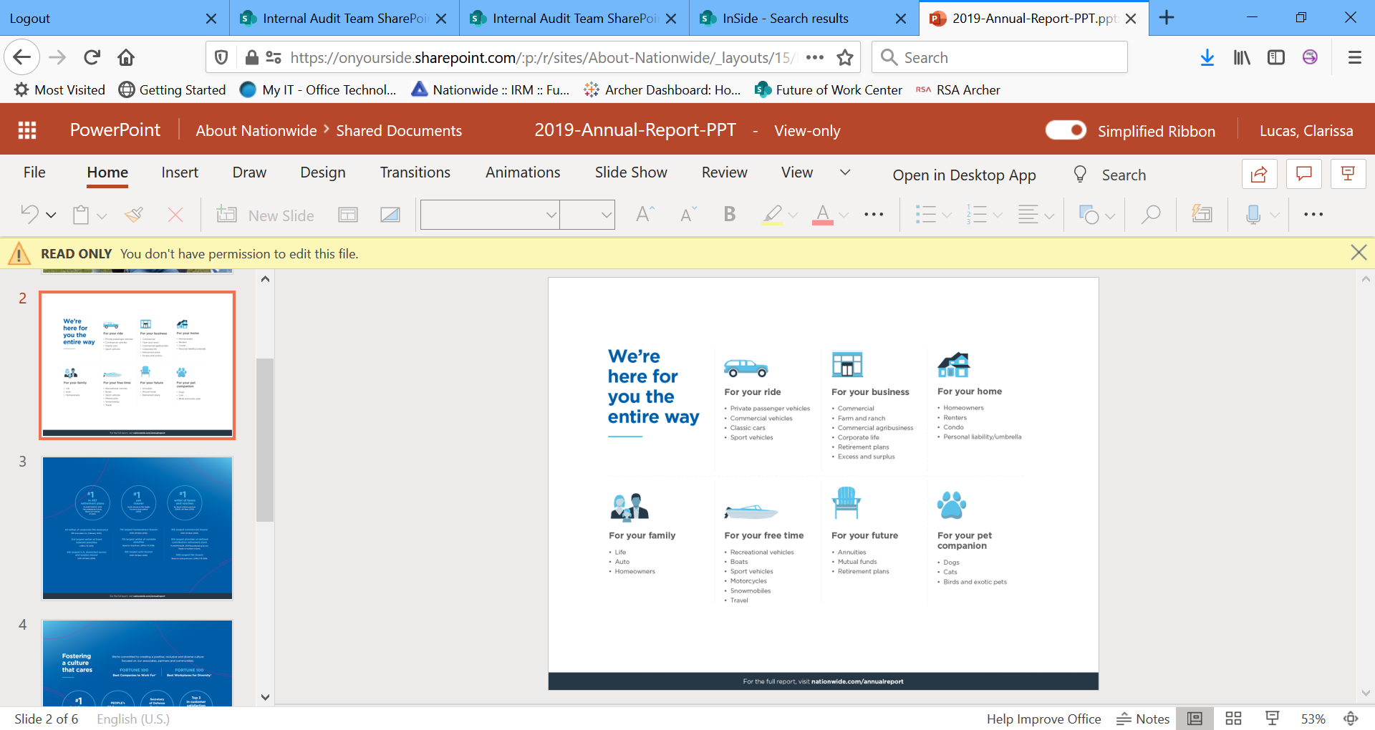
About Nationwide

Slide 4
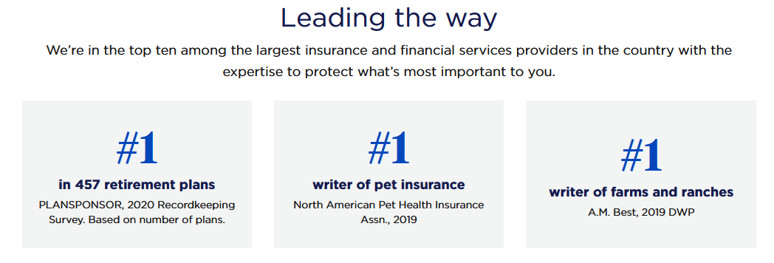
About Nationwide

Slide 5
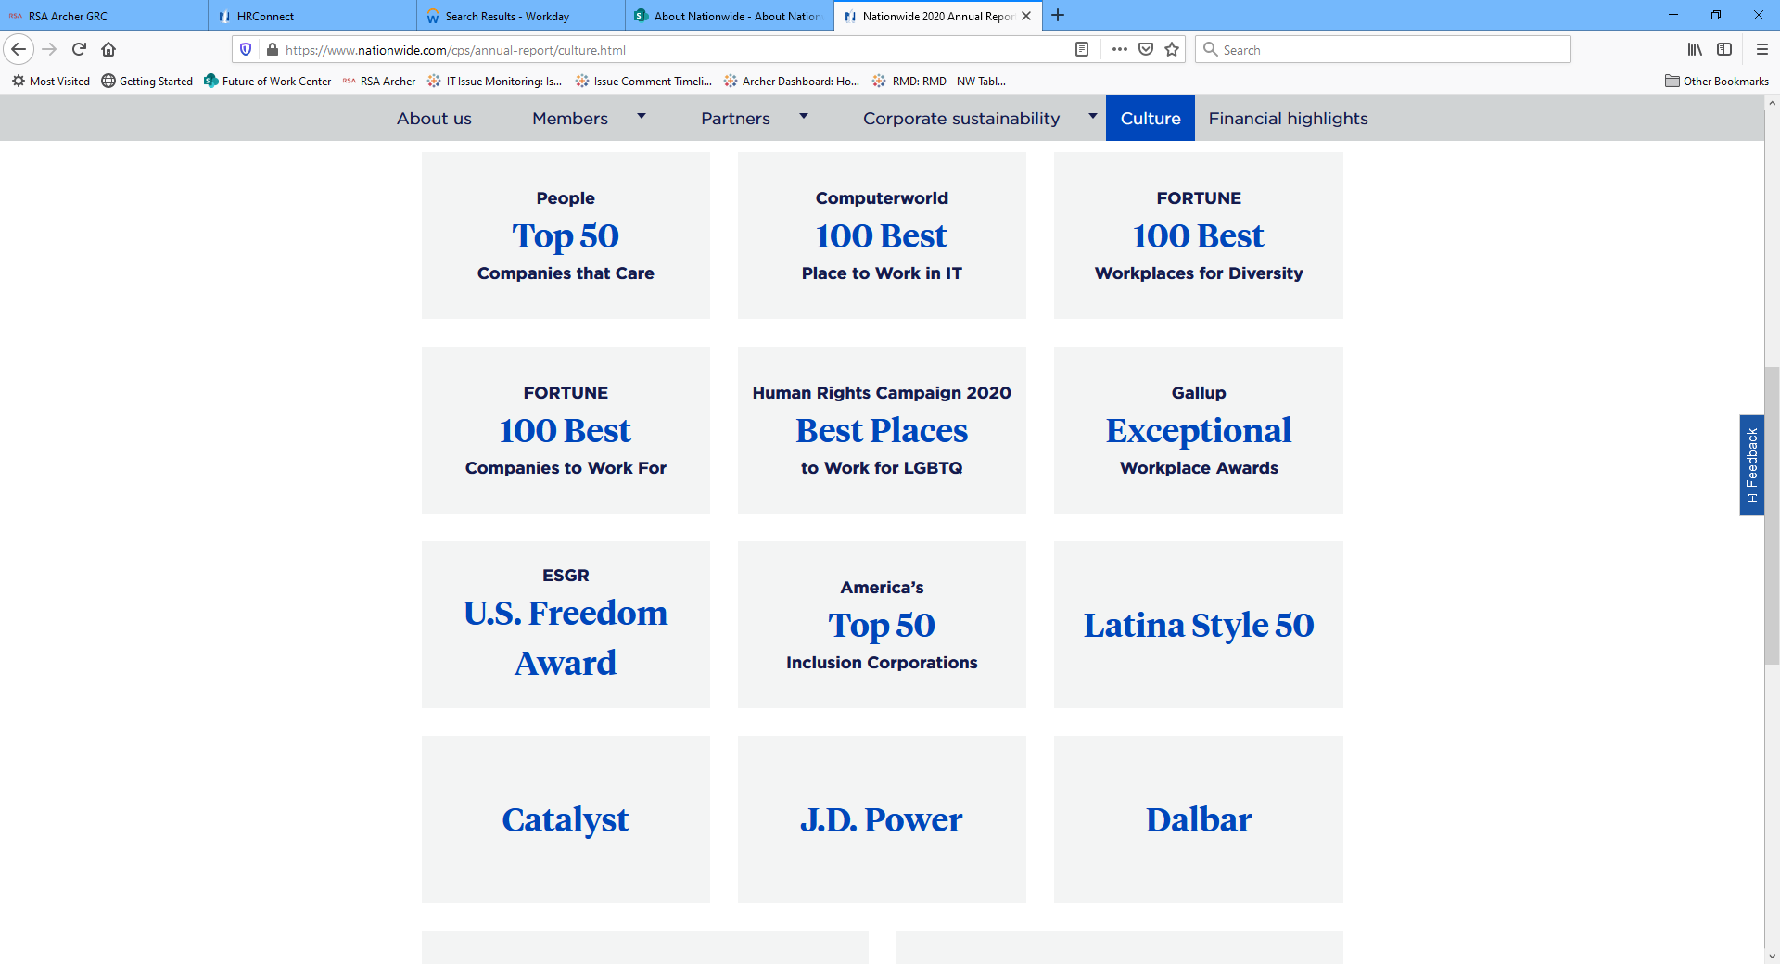
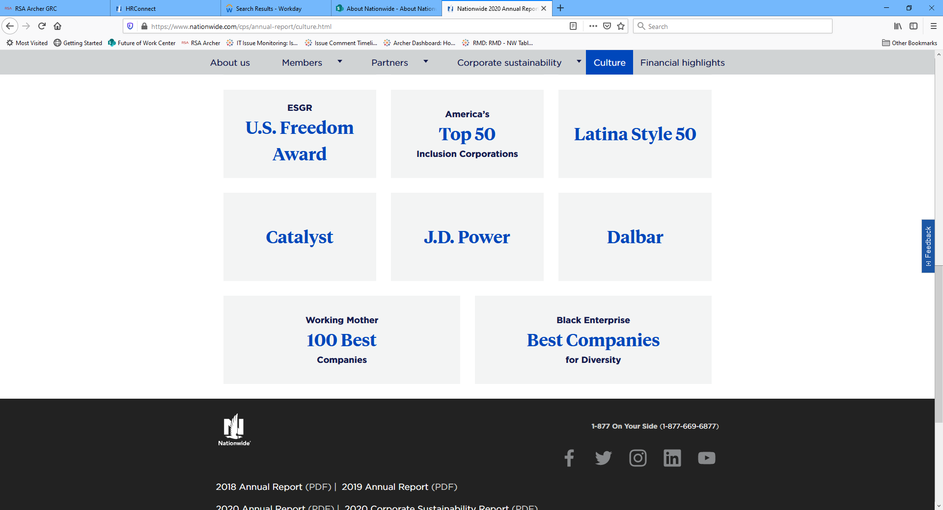
About Nationwide

Slide 6

Learning Objectives
By attending this session, attendees will:
Get a refresher on how to think about risks and controls in a DevOps operating model.
Learn how increased reliance on automation has impacted risk mitigation and control assessments.
Discover how Internal Audit has adopted Agile and DevOps practices.
This Photo by Unknown Author is licensed under CC BY-SA-NC

Slide 7
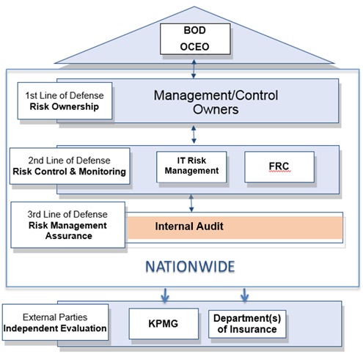
The Three Lines of Defense
Internal Audit
Our Purpose:
Provide independent assurance to the Audit Committee of the Board
Add value and improve operations
Evaluate and improve the effectiveness and efficiency of risk management, governance and control processes
Independently assess the adequacy and effectiveness of risk management and control activities
Link to DevOps through integrated audits
Test applications supporting key business processes
Primary controls:
Change management
User access
Interface integrity

Slide 8
Key Change Management Risks
Lack of proper mitigation controls may lead to decreased or compromised system/data availability, integrity, or confidentiality, resulting in adverse impact on business operations.
A strong control environment helps manage this risk by preventing:
Unauthorized changes introduced into production
Code that does not perform in alignment with expectations
Unidentified dependency issues
Changes resulting in unintended consequences
Introduction of security vulnerabilities

Slide 9
Traditional Change Management Controls
Approvals
Changes should be tested and approved before moving into production by a person other than the developer
Supporting documentation for changes should be maintained
Segregation of Duties
Migration of changes into production should be done by a person who is independent from the development team
Metrics Monitoring
Monitoring and reporting should be in place to determine effect of changes on business operations

Slide 10

SOD – Why?
Why do we separate certain duties?
To prevent…

Slide 11
SOD – Why?
Why do we separate certain duties?
To prevent…
Improper modification of data
Misappropriation of assets
Errors
Malicious acts
Erroneous changes to programs
Fraudulent acts

Slide 12

SOD – What if?

Slide 13
SOD – What if?
Review of transaction logs
Exception reporting
Automated enforcement of signed artifacts
Automated reviews/tests
Review of audit trail
Reconciliations

Slide 14
Risk and Internal Control Considerations
Category | Specific Risks | Controls
Governance | Developers may not be aware of secure coding techniques, security requirements and commonly occurring application vulnerabilities. | Developer application security training Documented policies and procedures
Secure Delivery Pipeline and Change Control | Poorly secured delivery pipeline may lead to production breaks and security vulnerabilities in applications. Implementing untested and/or unauthorized code may lead to increased operational failures, poor transaction processing, and unreliability of the system. Unauthorized changes may be deployed into production. | Protect source code Detect and address unencrypted sensitive data Automated application code vulnerability scanning Automated test execution Automated configuration vulnerability scanning Software dependency management Restricted access Automated production deployment process Access and activity logging Data protection Automated approvals and verifications
Operations | Without proper monitoring and metrics collection/review, technology performance may degrade over time. | Technology performance management Asset management and inventorying

Slide 15
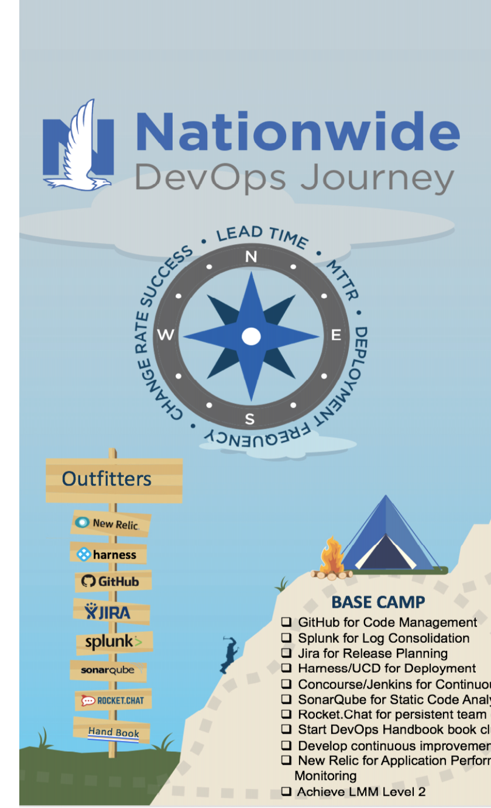
Build Team Highlight: Partners And Beyond
Using partner APIs to receive and dish out insurance quotes to customers
Replacing an on-prem app and building a new one in the cloud
Using managed ETL services and logging to stream and analyze data in real-time
Moving away from old mainframe scheduling to cron jobs
Leading through humility – whole team undergoing new process, platform, and languages with no prior experience
Top-down approval of the process so the team can self-manage

Slide 16
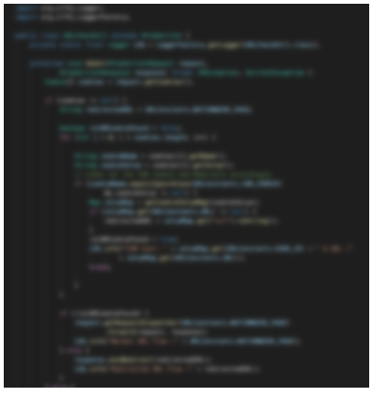
P&B: Automated Testing
"It's the Climb!" - T. Swift
Polyskilling and resource uplift happens through code reviews and oversight of the automating testing output.
Automated tests create one source of truth and make it easy to review and audit, where results are objective.
Tests should be simple, integrated into the pipeline with wide visibility of the results.
If the test fails, it will not package the application and commit until it passes.
P&B Progress:
Lead time reduction of 7 days
Iteration velocity up 24pts on avg
Devs no longer wait for a free tester
Faster releases on increased cadence
Notes:
Ethan

Slide 17
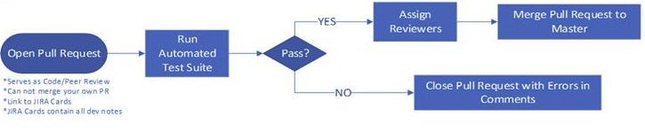
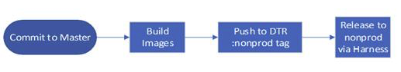
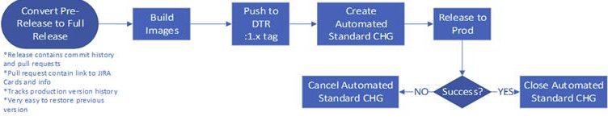
P&B: Automated Deployments
One big happy family
Commit linked to Jira cards
Git PR’s kick off automated test and serve as peer review
Still needs human approval after a code review, ensuring segregation of duties
A commit to the master branch will kick off the release process
Document and track the release all the way through the process
Faster deployments helps us achieve our goal of faster, more competitive speed-to-market.

Slide 18
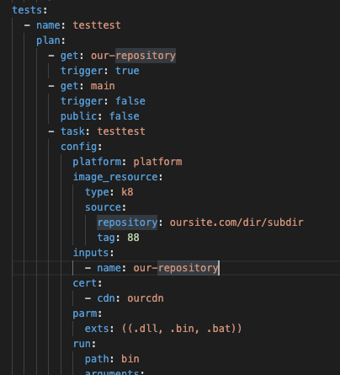
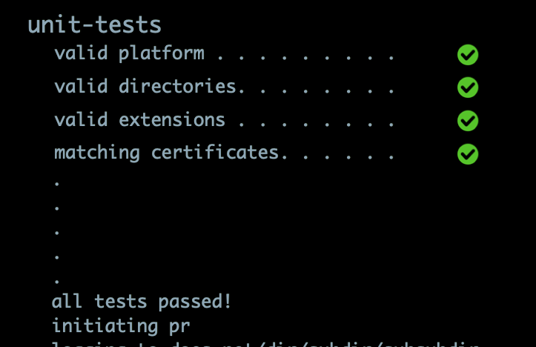
P&B: Automated Testing
Risk: Business disruption and downtime caused by introduction of code that doesn’t have sanitized and expected outputs
Control: Automated test checks code to determine if it matches requirements

Slide 19
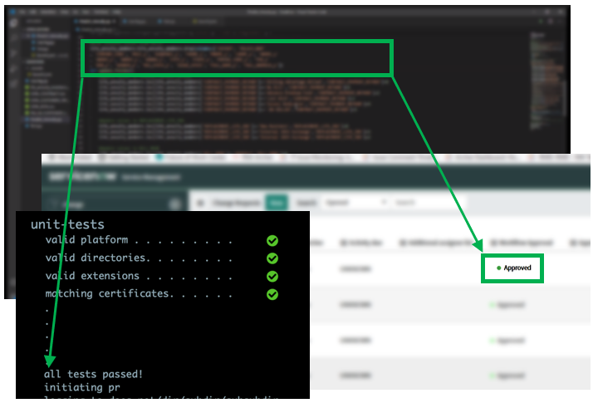
P&B: Automated Deployment
Risk: Business disruption and downtime caused by introduction of untested or unapproved code
Control: Automated deployment tool confirms that the code passed testing and that the change record is documented.

Slide 20
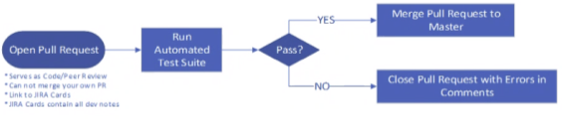
P&B: Automated Testing
Automated Test Suite – IA Approach
Is the test set up to do what it’s expected to do?
Did the test pass code as expected?
Did the test fail code as expected?

Slide 21
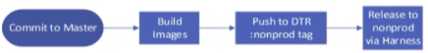
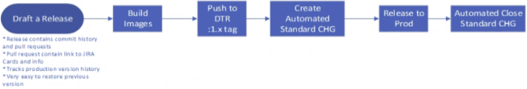
P&B: Automated Deployment
Automated Deployment – IA Approach
Is the deployment control set up to do what it’s expected to do?
Did the code deploy as expected?
Was the code rejected from deployment as expected?

Slide 22
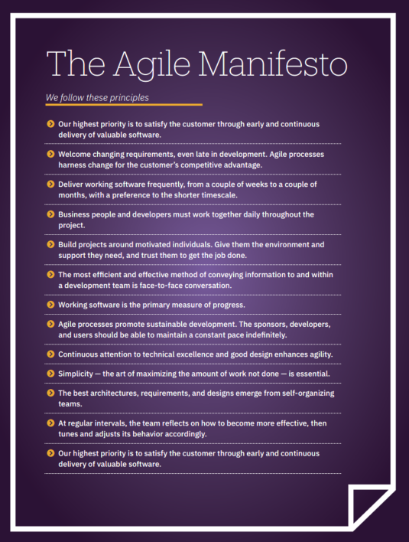
Agile Auditing Pilot #1: Financial Reporting Controls
The following agile and DevOps practices were successfully implemented on this engagement:
Self-organized teams
Avoid multitasking
Continuous delivery in short sprints
Working together frequently with stakeholders throughout the audit
Continuous feedback
Automation
Blameless retrospective/post-mortem
Source: https://info.wegalvanize.com/agile-auditing-ebook.html

Slide 23
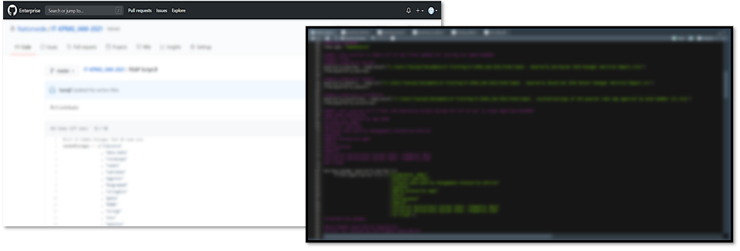
Agile Auditing Pilot #1: Financial Reporting Controls
Automate, Automate, Automate!
Some control tests were highly manual
Save about 15 hours of work to test attributes (for two controls)
Manual work reduced to investigation of items flagged as potential exceptions

Slide 24
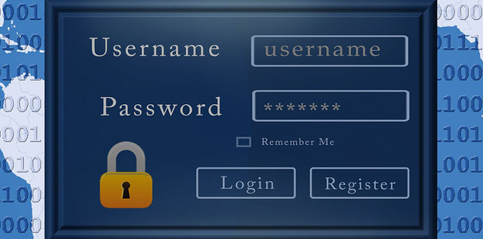
Agile Auditing Pilot #2: Identity and Access Management
Prioritize customer’s needs
Foster a collaborative environment (internally and with our clients)
Continuous delivery
Continual experimentation and learning
Self-Governing teams
Automation
Blameless retrospective/post-mortem

Slide 25

GREAT Partnership
What is the impact to your audit experience?
Why are DevOps and Audit a great partnership?
Less time spent being audited
Decreased interruption to daily responsibilities
Fewer requests for evidence/documentation to fulfill
Greater assurance via full population coverage
Stronger collaboration
Integration of audit into daily work
This Photo by Unknown Author is licensed under CC BY-SA-NC

Slide 26



Contact Information
Clarissa Lucas, Audit Director
Nationwide Insurance
lucasc5@nationwide.com
www.linkedin.com/in/clarissalucas
Rusty Lewis, Audit Specialist
Nationwide Insurance
lewir7@nationwide.com
www.linkedin.com/in/rusty-lewis-cpa-69a96347
Ethan Culp, NTEC Sr. Associate
Nationwide Insurance
culpe2@nationwide.com
www.linkedin.com/in/ethanculp/

